Slide 1










POLITEKNIK NEGERI BATAM | SMT 4
Mobile Scale Application
TRM409 | TIM 4
Teknik Rekayasa Multimedia

Slide 2




TEKNIK REKAYASA MULTIMEDIA
Manager
Project
Mr. Agung Riyadi, S.Si., M.Kom.
Aplikasi Mobile Scale | Tim 4
Halaman 02

Slide 3
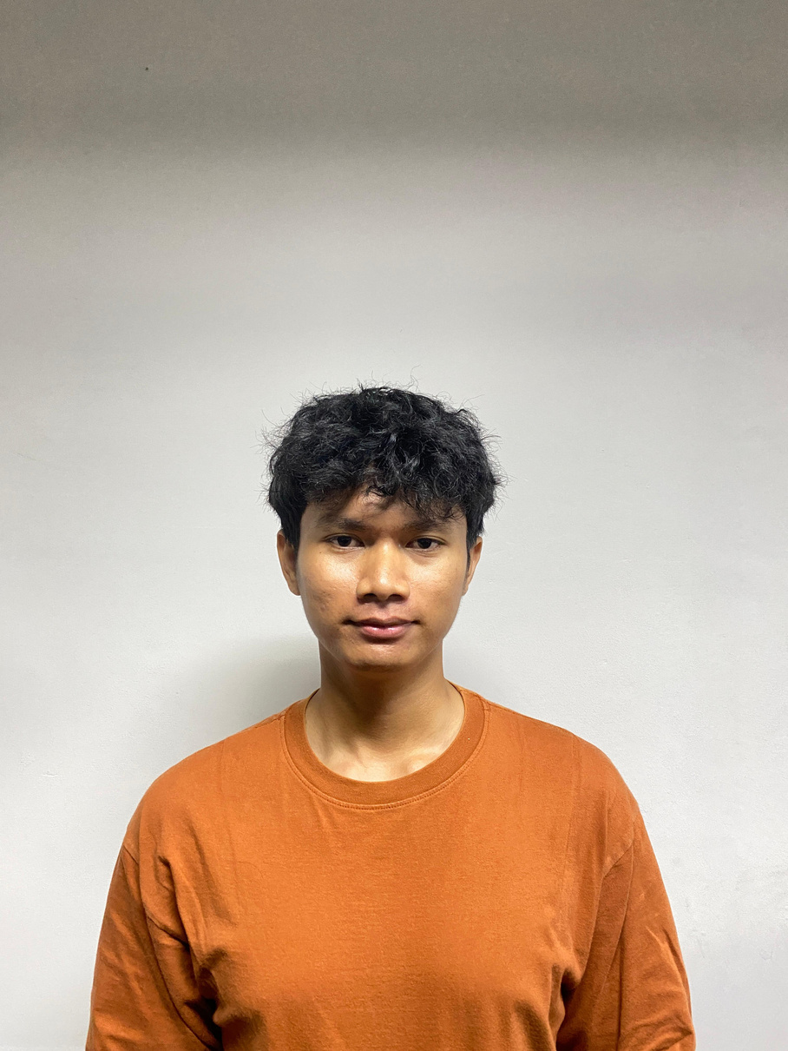
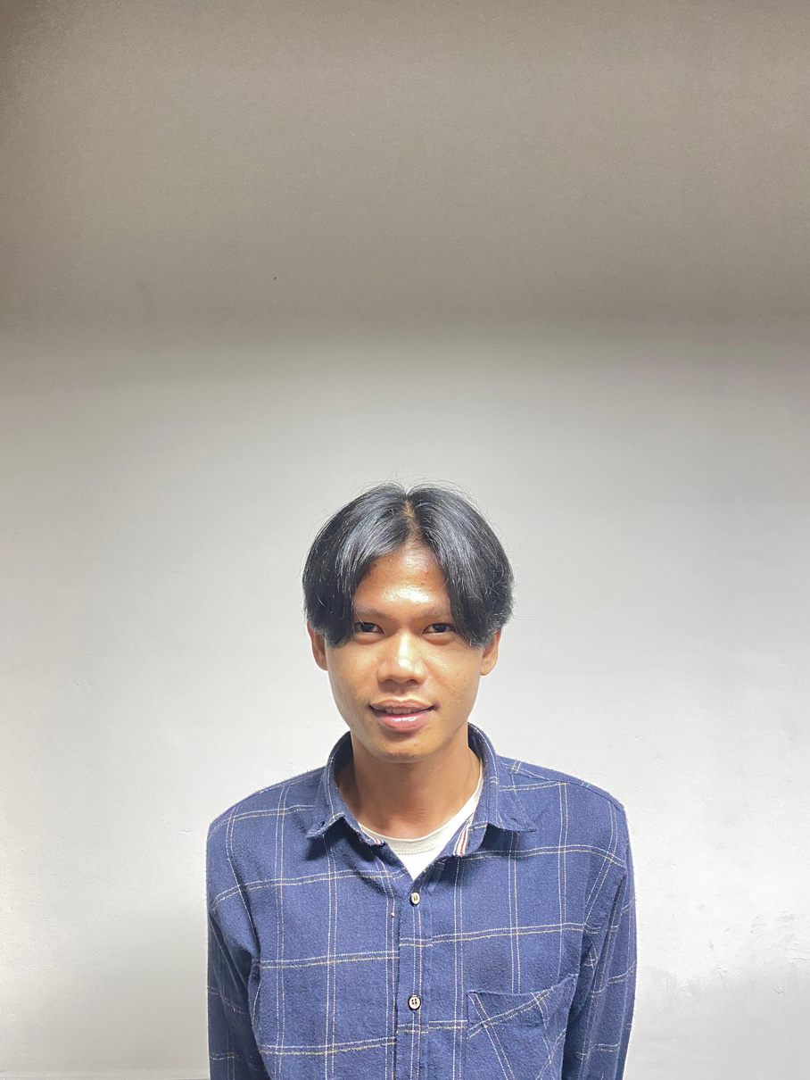

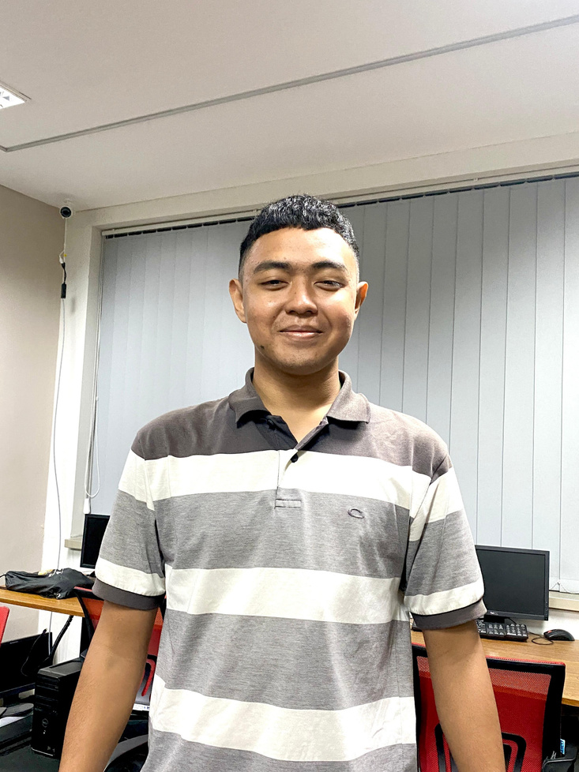



TEKNIK REKAYASA MULTIMEDIA
Group Members
DWI KURNIA S
4312211020
LEADER
DWIKI KHARISMA
4312211025
MEMBER
JESI AFRIANA
4312211029
MEMBER
M. REZA AL FARIZI
4312211023
MEMBER
ABDUL AJIS
4312211006
MEMBER
Aplikasi Mobile Scale | Tim 4
Halaman 03

Slide 4
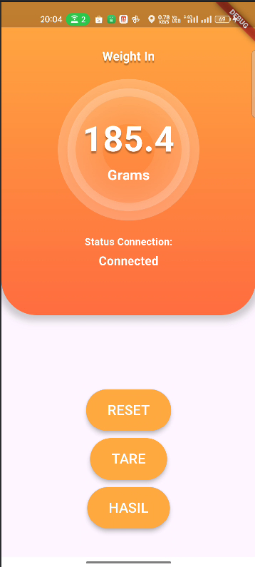
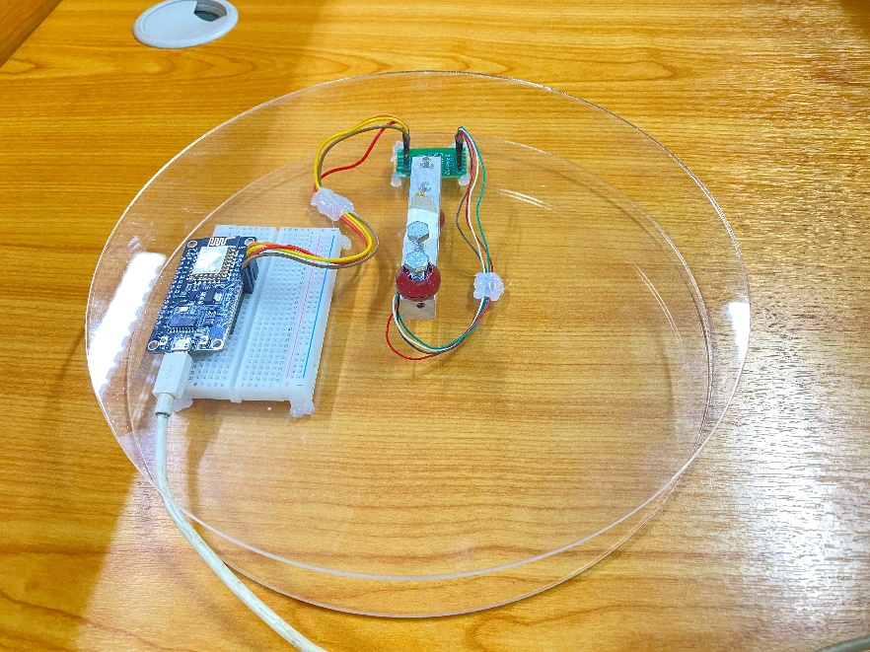
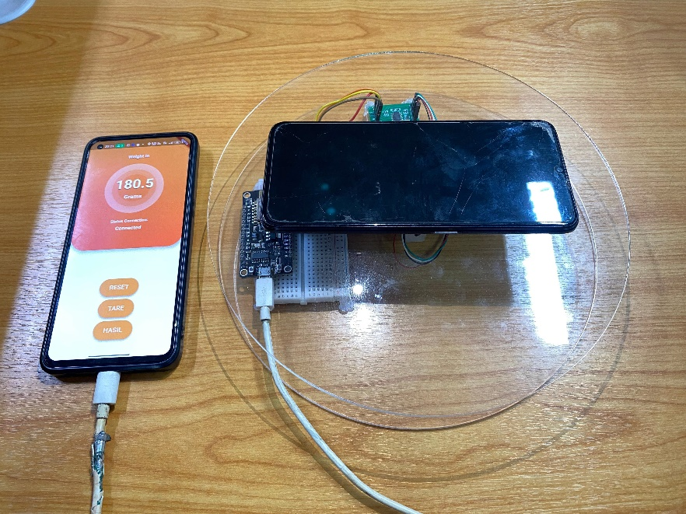
TEKNIK REKAYASA MULTIMEDIA
Project Description
Mobile Scale App
Aplikasi Mobile Scale | Tim 4
Halaman 04

Slide 5
TEKNIK REKAYASA MULTIMEDIA
Contribution of PBL course
Computer System Administration
Object Oriented Programming
Computer System Administration course contributions will learn basic concepts about installation and configuration management. They can apply this knowledge to manage the infrastructure required to run mobile weighing applications, such as data storage servers or communication servers.
Contribution The OOP course teaches about the principles of object-oriented design, including the use of classes, objects, encapsulation, inheritance, and polymorphism. Apply the concepts in designing program structures for mobile scale applications, making it easier to manage code
Aplikasi Mobile Scale | Tim 4
Halaman 05

Slide 6
TEKNIK REKAYASA MULTIMEDIA
Contribution of PBL course
Mobile Device Programming
System IoT
Multimedia
This course teaches the skills needed to develop mobile apps using Dart programming language. In the context of a mobile scale app project, students will learn about the technologies used to develop responsive and easy-to-use mobile apps.
The IoT Systems course makes it possible to understand the concepts and technologies of sensors and actuators used in mobile scale projects. They can learn about the types of sensors used to measure weight or mass, as well as how to connect these sensors to IoT platform.
Aplikasi Mobile Scale | Tim 4
Halaman 06

Slide 7
TEKNIK REKAYASA MULTIMEDIA
Contribution of PBL course
General English
Civic Education
Statistic
The Statistics course helps students to understand and analyze data generated by mobile scale applications. They can use statistical methods to identify patterns and relevant insights from the weight measurement data collected by the app.
This course can help students in public speaking. Students will learn how to organize and deliver project presentations effectively, including explaining the concepts, features, and benefits of the mobile scale application project smoothly and convincingly.
This course will discuss the ethical use of technology and social responsibility in app development. In a mobile scale application project, we will learn about the importance of developing applications with ethical principles in mind, including user privacy and data security.
Aplikasi Mobile Scale | Tim 4
Halaman 07

Slide 8
TEKNIK REKAYASA MULTIMEDIA
Project Reach
01. PROJECT REPORT
05. MANUAL BOOK
02. MOBILE BASED APPLICATION
06. POSTER
03. IOT HARDWARE
07. HKI SUBMISSION DOCUMENT
04. APPLICATION DEMO VIDEO
08. PBL HANDOVER PROTOCOL
Aplikasi Mobile Scale | Tim 4
Halaman 08

Slide 9
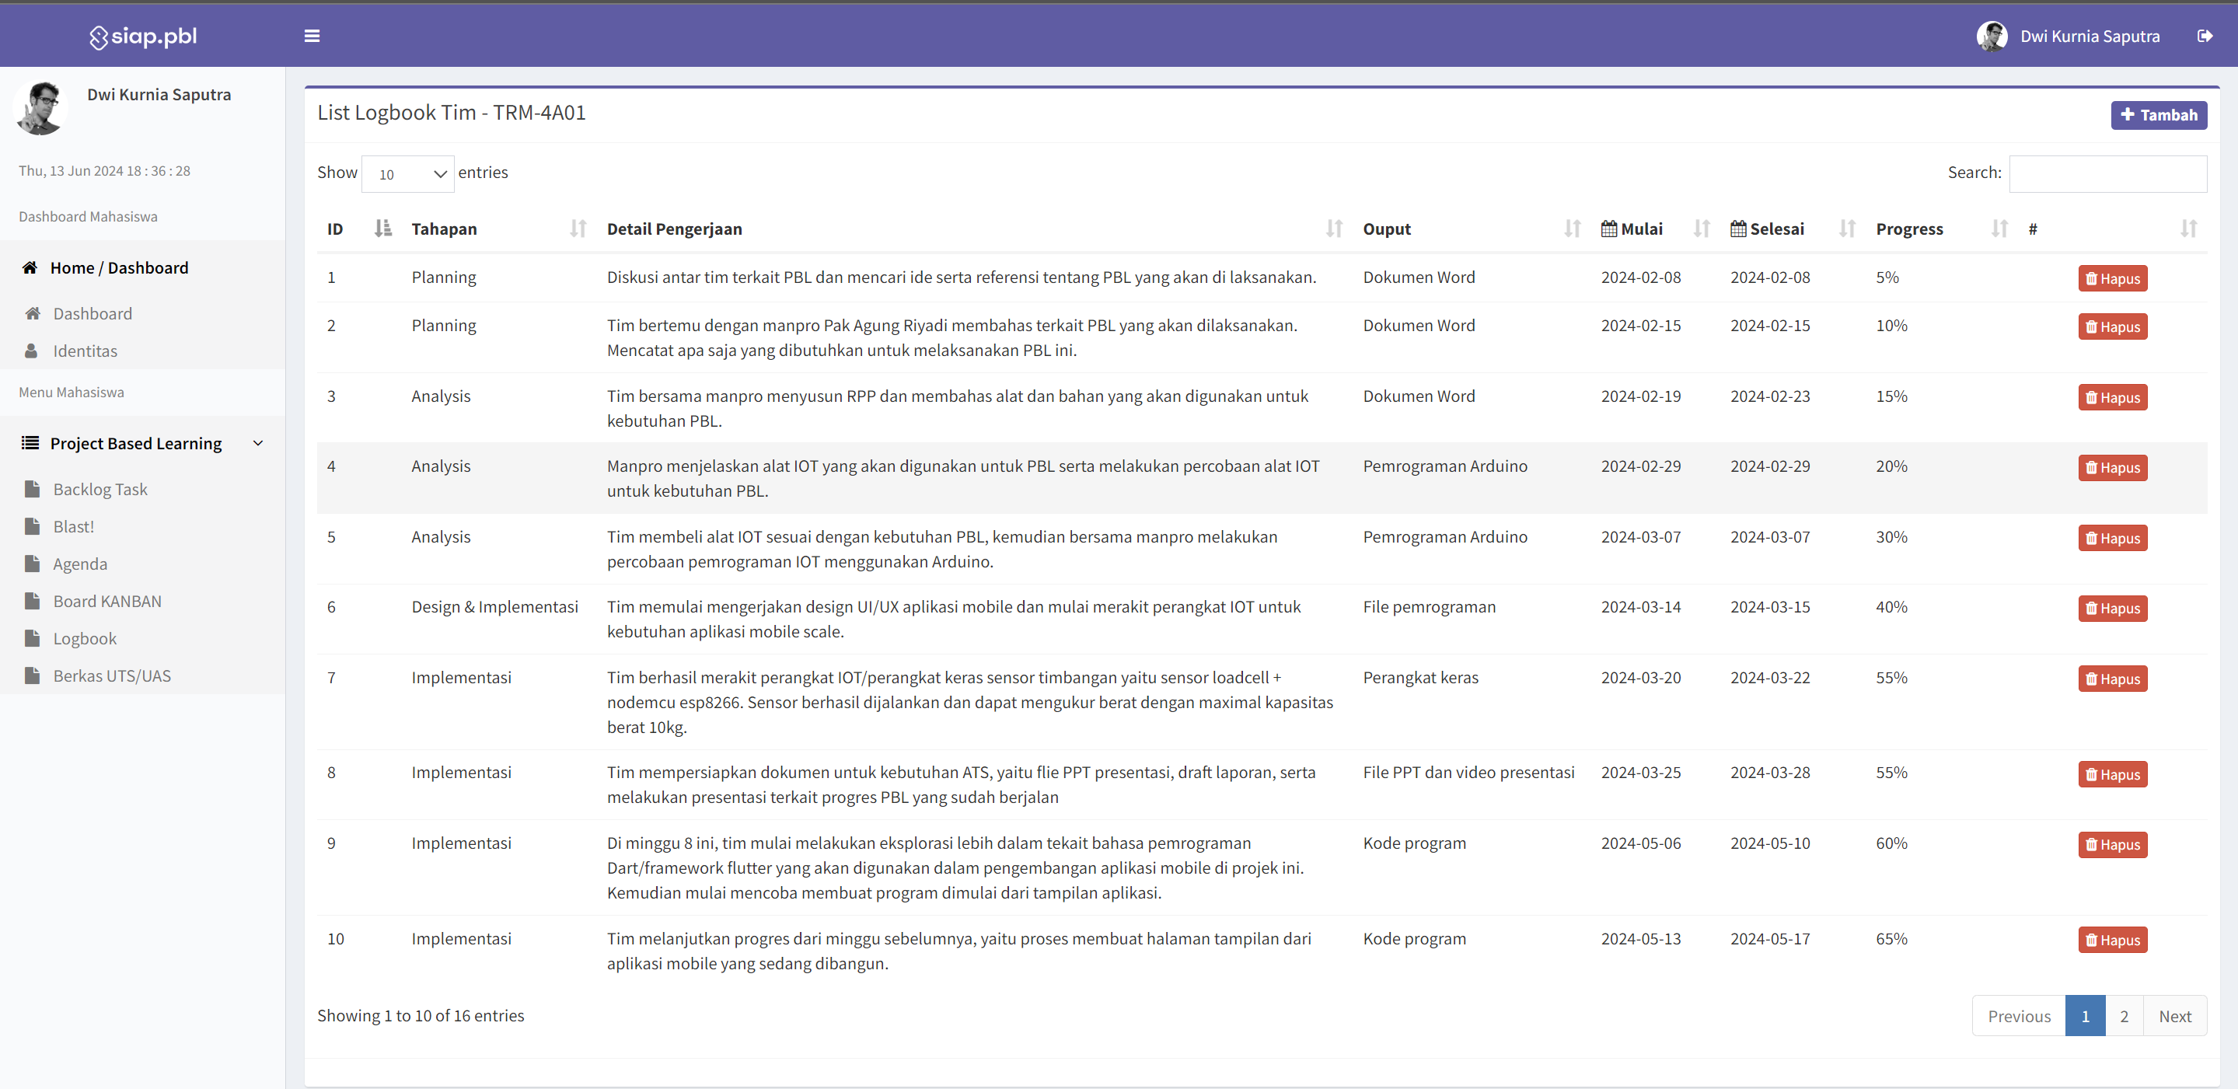
TEKNIK REKAYASA MULTIMEDIA
Logbook
Aplikasi Mobile Scale | Tim 4
Halaman 09

Slide 10
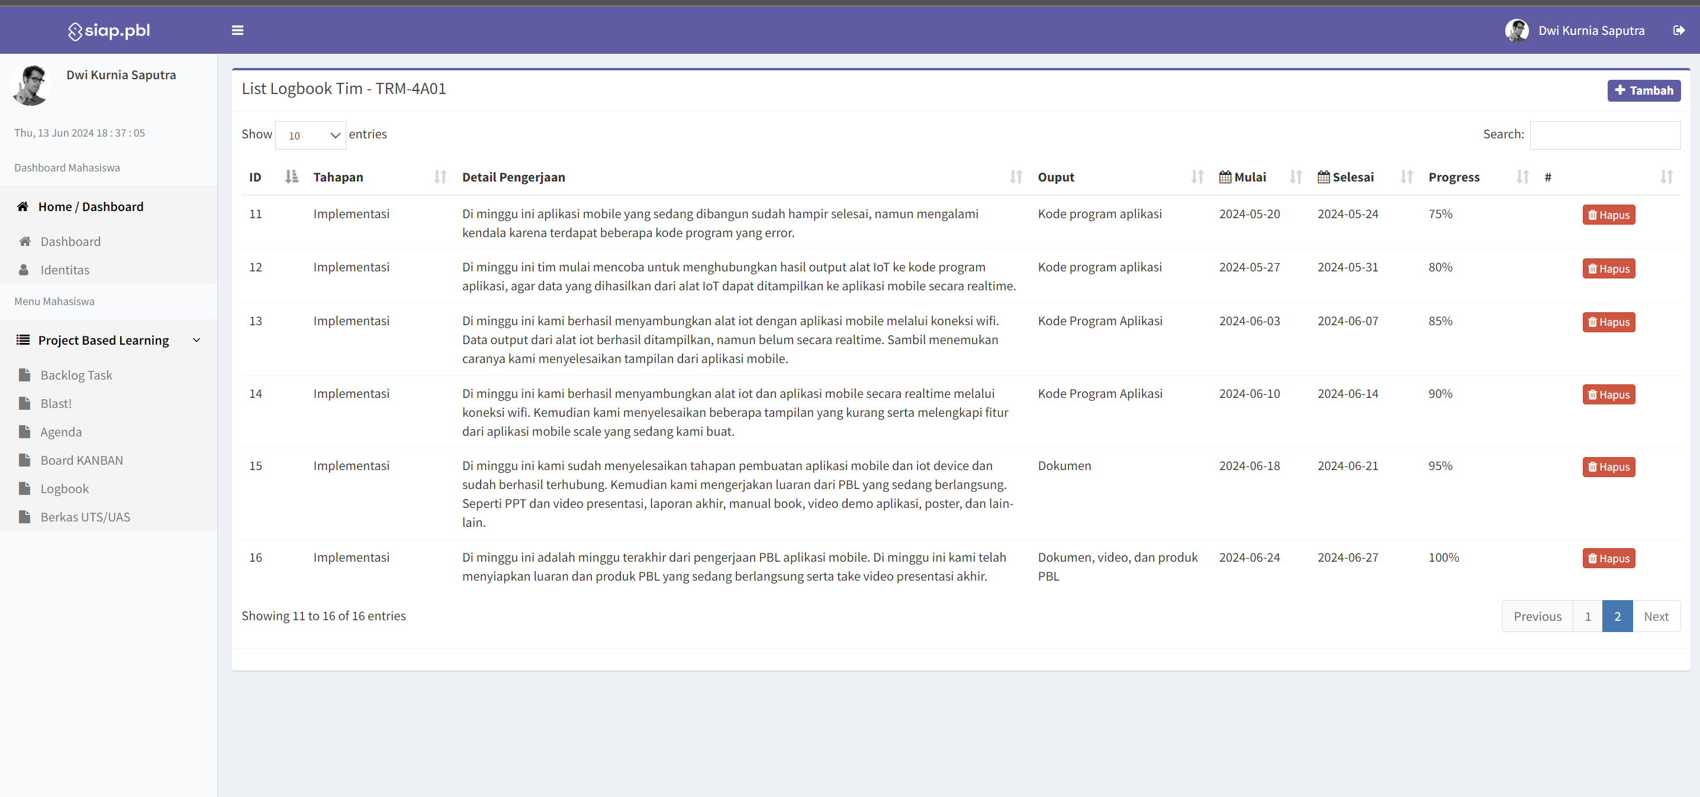
TEKNIK REKAYASA MULTIMEDIA
Logbook
Aplikasi Mobile Scale | Tim 4
Halaman 10

Slide 11
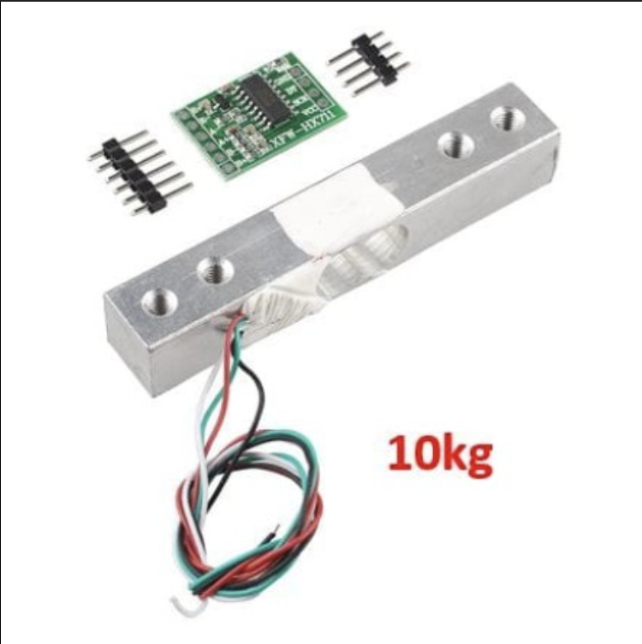
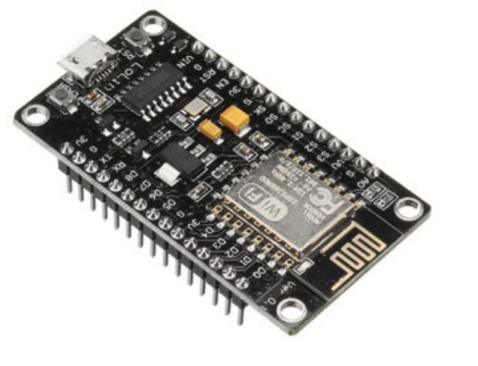
TEKNIK REKAYASA MULTIMEDIA
Project Work Details
IoT Device & Components
IoT Device connected to phone
IoT Device Scale
Microcontroller ESP8266
LoadCell 10kg + Sensor HX711
Aplikasi Mobile Scale | Tim 4
Halaman 11

Slide 12
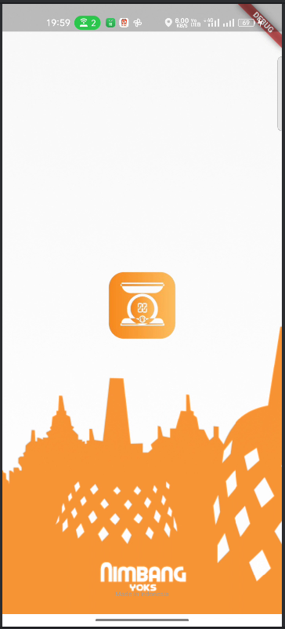
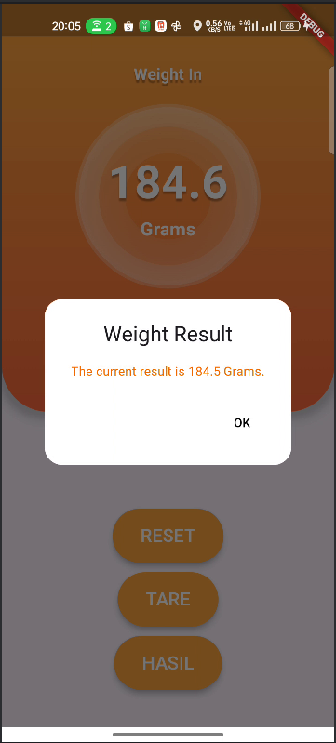

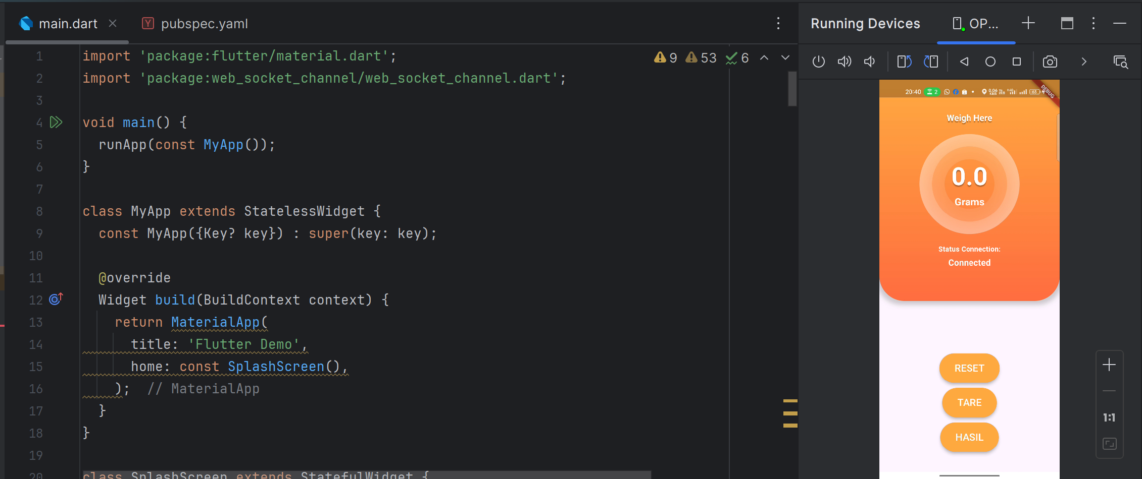
TEKNIK REKAYASA MULTIMEDIA
Project Work Details
Mobile Application
Aplikasi Mobile Scale | Tim 4
Halaman 12

Slide 13
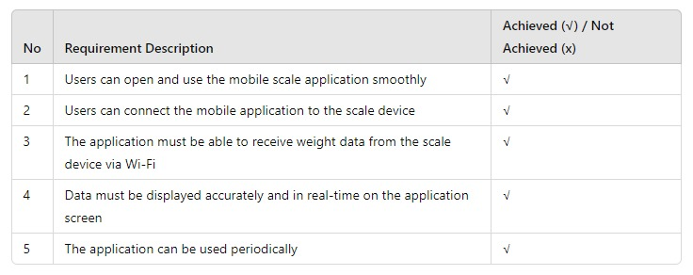
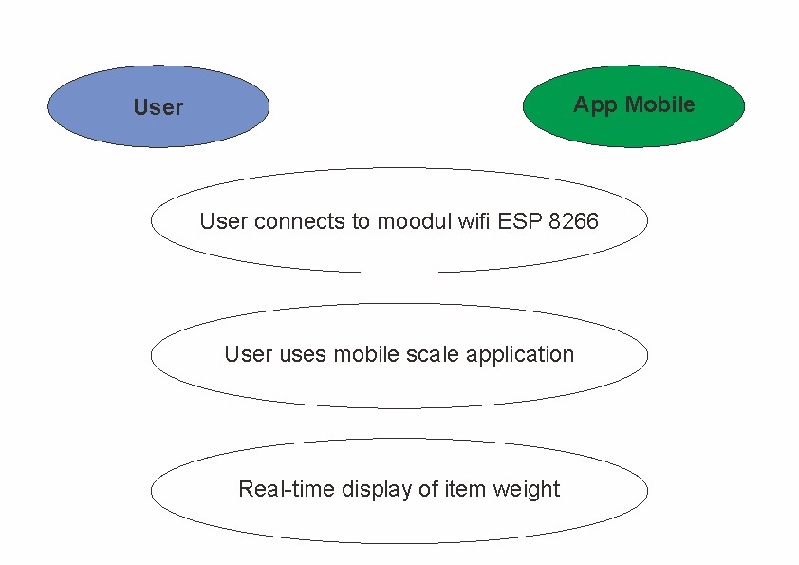
TEKNIK REKAYASA MULTIMEDIA
Project Work Details
Functional System
Use Case
Aplikasi Mobile Scale | Tim 4
Halaman 13

Slide 14
RELEVANCE TO THE COURSE
TEKNIK REKAYASA MULTIMEDIA
1. Multimedia IoT System
The relevance of this course is in the manufacture of IoT hardware and programming code.
2. Mobile Device Programming
The relevance of this course is in making mobile applications using the dart programming
language.
3. Statistics
The relevance of this course is in testing data and application functions
4. Object Oriented Programming
The relevance of this course is on the logic of programming languages
5. General English
English plays an important role for this project because some programming languages use
English.
6. Computer System Administration
The relevance of this course is in the computer system section
7. Civic Education
Students can apply the leadership and cooperation skills learned in Civic Education to
manage the project efficiently, divide tasks fairly and ensure all team members contribute
Aplikasi Mobile Scale | Tim 4
Halaman 14

Slide 15
TEKNIK REKAYASA MULTIMEDIA
DIVISION OF TEAMWORK
01.
02.
03.
DWI KURNIA SAPUTRA
DWIKI KHARISMA
JESI AFRIANA
HARDWARE IOT DEVELOPMENT
APPLICATION DEVELOPMENT SUPPORT
FILING SECTION
04.
05.
M. REZA AL FARIZI
ABDUL AJIS
APPLICATION DEVELOPMENT
TECHNICAL SUPPORT
UI/UX DESIGNER
Aplikasi Mobile Scale | Tim 4
Halaman 15

Slide 16
TEKNIK REKAYASA MULTIMEDIA
Obstacle Faced
The challenges we face in carrying out this project include our limited understanding of Arduino programming and assembling IoT hardware. Additionally, building a mobile application using the Dart programming language is new to us, resulting in some mistakes made at the beginning of the project. Therefore, we need to learn more to successfully complete this project.
Aplikasi Mobile Scale | Tim 4
Halaman 16

Slide 17
TEKNIK REKAYASA MULTIMEDIA
Next Work Plan
By the end of the semester, we had completed 100% of this project. We have successfully developed the hardware for the scale and successfully weighed an object accurately. Mobile application based on the UI/UX design that we have completed. And the weighing result can be displayed accurately on the mobile application.
Aplikasi Mobile Scale | Tim 4
Halaman 17

Slide 18
POLITEKNIK NEGERI BATAM | SMT 4
Thank You
TRM409 | TIM 4
Mobile Scale Application
Teknik Rekayasa Multimedia

